Slide 1
Aacs 2034
fundamentals of computer network

Slide 2
INTRODUCTION
1 set assignment question
Able to use digital resources
Classes addressing + growth table +Implementation of Variable Length Subnet Mask (VLSM) + addressing table

Slide 3
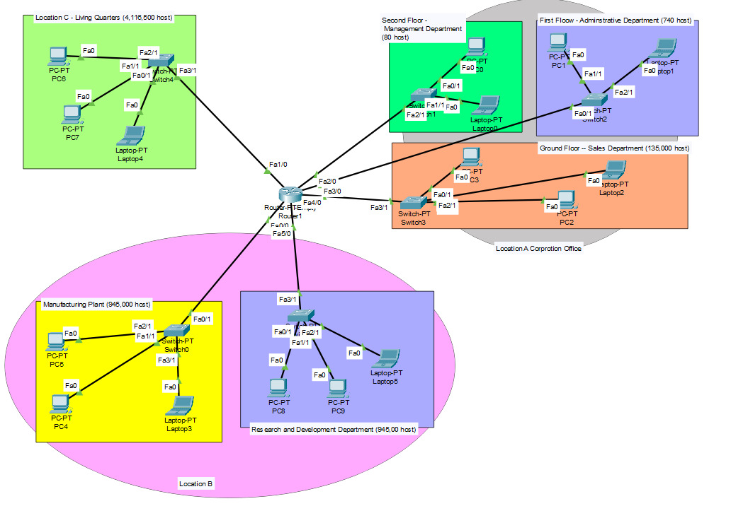
NETWORK DESIGN

Slide 4
INTRODUCTION
Class A
Private Address
10.0.0.0 to 10.255.255.255
Default Subnet Mask
255.0.0.0
1 network portion and 3 host portion

Slide 5
The Host required in each department
LIVING QUARTERS
4,116,500 HOSTS REQUIRED
MANUFACTURING PLANT
1,356,720 HOSTS REQUIRED
RESEARCH AND DEVELOPMENT DEPARTMENT
945,000 HOSTS REQUIRED
SALES DEPARTMENT
135,000 HOSTS REQUIRED
ADMINISTRATIVE DEPARTMENT
740 HOSTS REQUIRED
MANAGEMENT DEPARTMENT
80 HOSTS REQUIRED

Slide 6
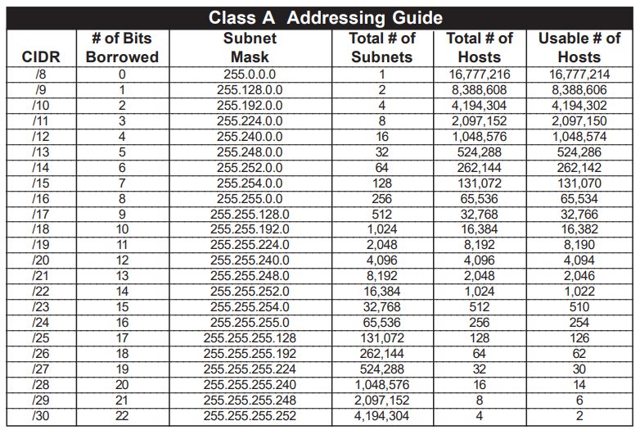
Find cidr and subnet mask for each department
LOCATION C (LIVING QUARTERS)
- 4,116,500 HOSTS
LOCATION B (MANUFACTURING PLANT) - 1,356,720 HOSTS
LOCATION B (RESEARCH AND DEVELOPMENT DEPARTMENT) - 945,000 HOSTS
LOCATION A (SALES DEPARTMENT) - 135,000 HOSTS
LOCATION B (ADMINISTRATIVE DEPARTMENT) - 740 HOSTS
LOCATION B (MANAGEMENT DEPARTMENT) - 80 HOSTS

Slide 7
GROWTH TABLE
 | BEFORE GROWTH | AFTER 85% GROWTH
LIVING QUARTERS | 4,116,500 | 7,615,525
MANUFACTURING PLANT | 1,356,720 | 2,509,932
RESEARCH AND DEVELOPMENT DEPARTMENT | 945,000 | 1,748,250
SALES DEPARTMENT | 135,000 | 249,750
ADMINISTRATIVE DEPARTMENT | 740 | 1,369
MANAGEMENT DEPARTMENT | 80 | 148

Slide 8
Find subnet mask for each department
Byte 1 | Byte 2 | Byte 3 | Byte 4
N | H | H | H
1111 1111 | 1000 0000 | 0000 0000 | 0000 0000
10 | 2^7 = 128 | 0 | 0
LOCATION (DEPARTMENT) | CIDR | SUBNET ADDRESS
LOCATION C (LIVING QUARTERS ) | /9 | 10.0.0.0
LOCATION B (MANUFACTURING PLANT) | /10 | 10.128.0.0
LOCATION B (RESEARCH AND DEVELOPMENT DEPARTMENT) | /11 | 10.192.0.0
LOCATION A (SALES DEPARTMENT) | /14 | 10.224.0.0
LOCATION A (ADMINISTRATIVE DEPARTMENT) | /21 | 10.228.0.0
LOCATION A (MANAGEMENT DEPARTMENT) | /24 | 10.228.8.0
1111 1111 | 1100 0000 | 0000 0000 | 0000 0000
10 | (2^6) + 128 = 192 | 0 | 0

Slide 9
Find the first usable , last usable and broadcast address
LOCATION (DEPARTMENT) | Subnet Address | First Usable | Last Usable | Broadcast Address
LOCATION C (LIVING QUARTERS ) | 10.0.0.0 | 10.0.0.1 | 10.127.255.254 | 10.127.255.255
LOCATION B (MANUFACTURING PLANT) | 10.128.0.0 | 10.128.0.1 | 10.191.255.254 | 10.191.255.255
LOCATION B (RESEARCH AND DEVELOPMENT DEPARTMENT) | 10.192.0.0 | 10.192.0.1 | 10.223.255.254 | 10.223.255.255
LOCATION A (SALES DEPARTMENT) | 10.224.0.0 | 10.224.0.1 | 10.227.255.254 | 10.227.255.255
LOCATION A (ADMINISTRATIVE DEPARTMENT) | 10.228.0.0 | 10.228.0.1 | 10.228.7.254 | 10.228.7.255
LOCATION A (MANAGEMENT DEPARTMENT) | 10.228.8.0 | 10.228.8.1 | 10.228.8.254 | 10.228.8.255

Slide 10
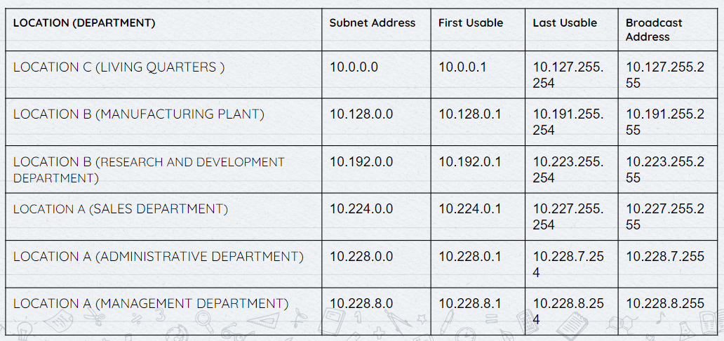
ADDRESSING TABLE
Assign the first usable IP address to Router
Assign the last usable IP address for Host

Slide 11
CONFIGURATION
CONSOLE LINE PASSWORD | C!sco
PRIVILEGED EXEC MODE (SECRET PASSWORD) | AACS2034

Slide 12
- SET banner - -
- Set hostname - -

Slide 13
Set ip address , subnet mask and default gateway
In router and switches
In PC and Laptop
Router – Fa0/0 (10.128.1.1, 255.192.0.0)
Switch 1 - (10.228.8.2, 255.255.255.0, 10.228.8.1)
PC 0 - (10.228.8.254, 255.255.255.0, 10.228.0.1)
PC 2 - (10.227.255.254, 255.252.0.0, 10.224.0.1)

Slide 14
THANK YOU

